Slide 1

HR ANALYTICS
Prepared by,
Reeba Mary Varghese

Slide 2
OVERVIEW
Problem Statement
Exploratory Data Analysis
Key Findings
Data Modelling and Predictive Analysis
Recommendations

Slide 3
PROBLEM STATEMENT
BusyQA training institute wishes to expand to manpower recruitment in data science domain
The company needs to connect enrollees of its training programs with its clients in the Analytics domain who are hiring
Business Problem : The company wants to know which of its candidates are seeking a job change and the factors that drive the decision
BusyQA requires a predictive model that uses information regarding its enrollees to predict the probability that they are looking for a job change

Slide 4
Exploratory data analysis
The following data about enrollees is available for analysis :
City, Gender, Relevant Experience, Education Level, University Enrollment, Major Discipline, Experience, City Development Index, Training Hours, Company Size, Company Type, Last New Job, and Target
The data is explored, cleaned, and prepared for analysis as a part of which
Outliners in data are noted, null values are dropped and inconsistent data is treated
Data is analyzed and visualized to unveil key trends and insights

Slide 5
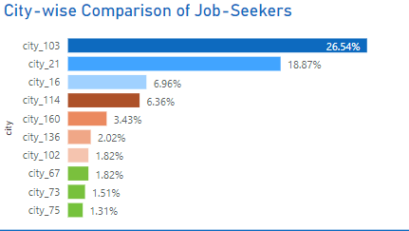
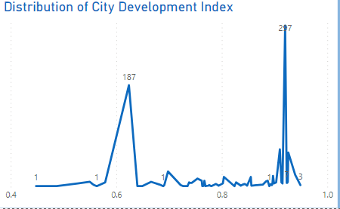
Key Findings
The top 5 cities from which job-seeking enrollees come from are city_103, city_21, city_16,city_114 and city_160
Average city development index of the cities of job-seeking enrolees in 0.848
75% of job-seekers are from cities that have a city development index of 0.92 or less

Slide 6
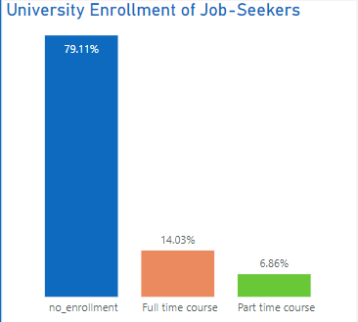
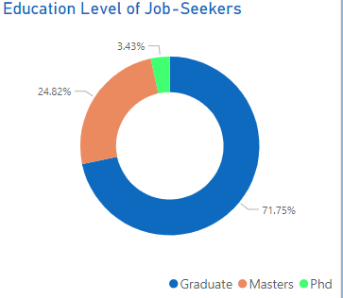
Key Findings
79% of active job seekers are not enrolled in any University courses
72% of enrollees who are actively seeking a job change are of Graduate education level

Slide 7
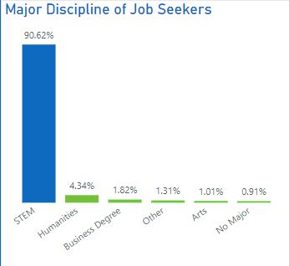
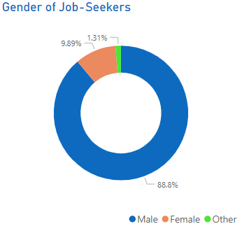
Key Findings
91% of enrollees who are looking for new jobs have a background in STEM
88.8% of the job-seeking enrollees are males

Slide 8
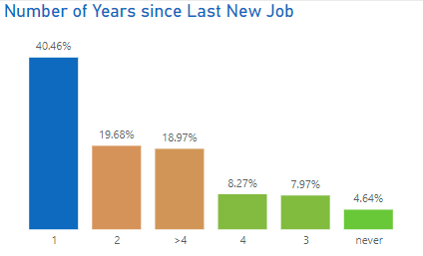
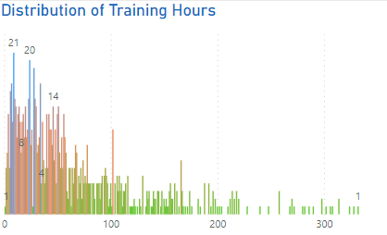
Key Findings
40.5% of enrollees who are seeking a job change have changed their job frequently
However, 19.7 % of job-seeking enrollees are looking for a new job after spending a considerable time of 4 + years in their last job
75% of them spend less than or equal to 84.5 hours in training
Enrollees looking for jobs do not spend high time in training

Slide 9
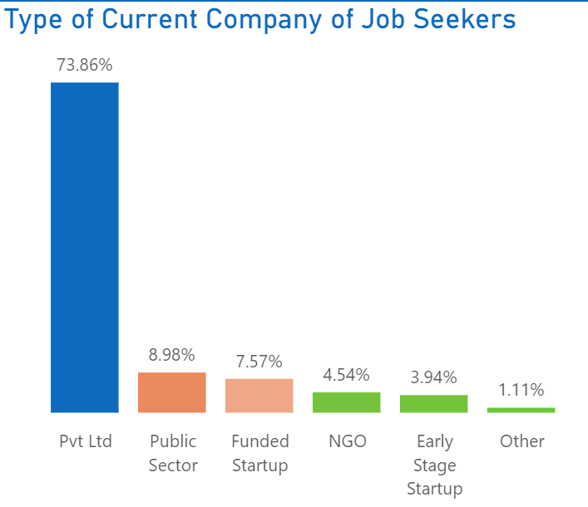
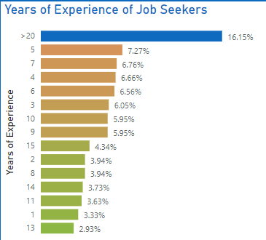
Key Findings
74% of the job-seeking enrollees are employed in the private sector.
The highest number of job-seeking enrollees have more than 20 years of experience
Enrollees with fewer years of experience are not the prominent job-seekers

Slide 10
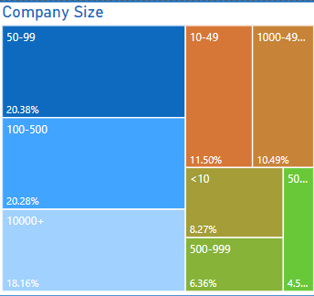
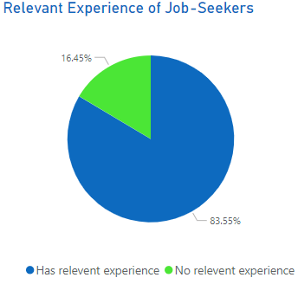
Key Findings
Most of the job-seeking enrollees currently work in companies with a number of employees in the range of 50-500 and 10000+
83.6% of active job-seeking trainees have relevant experience in the field

Slide 11
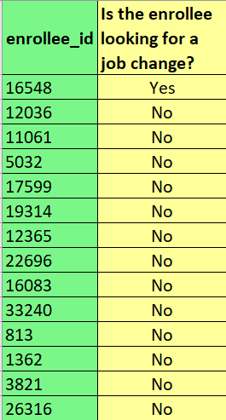
predictive modelLing
Using a Machine Learning model with the highest score (Logistic Regression model – 89.1% accuracy) predictions were made if enrollees would be seeking a job change or not
This model helps BusyQA understand if their trainees are seeking a job change and thus the company can recognize the best candidates to be connected with their clients

Slide 12
RECOMMENDATIONS
BusyQA can consider carrying out more marketing activities in city_103,city_21,city_16,city_114 and city_160 in order to further attract job -seeking candidates
The company can focus more on connecting candidates, who work in the private sector in companies with sizes in the range of 50-500 and 10000+, with their clients
Majority of candidates to be connected with clients would possess relevant experience in the field, opt to change jobs frequently, and possess more than 20 years of total experience
BusyQA can identify potential job-seekers as those who mostly have a Graduate education level, background in STEM, no university enrollment, do not choose a high number of training hours, and are mostly males

Slide 13
Thank You !!!

Slide 14
Questions ???

